Slide 1
FINAL DATA ANALYSIS REPORT
Exploratory Data Analysis on US Accidents Dataset (2016–2021)
By Himanshu Kushwaha

Slide 2

Dataset overview
Dataset Name - US Accidents (2016 - 2023)
Source - Kaggle, compiled by Sobhan Moosavi Real-time data from traffic service
Dataset Size - 7.7 millions records (46 columns)
Purpose - To explore and analyze the US Accidents Dataset in order to identify patterns, trends, and key factors contributing to road accidents across the country. This EDA helps in understanding accident severity, timing, locations, and environmental conditions for better insights and future predictions.

Slide 3
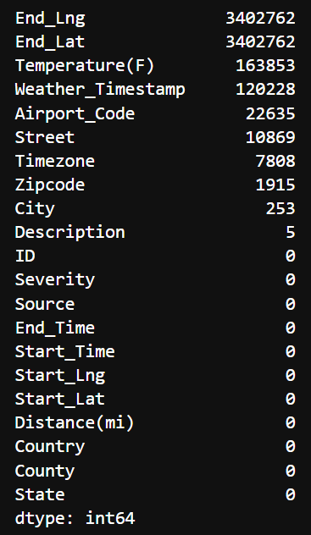
Data Cleaning & Removing Nulls
NULL Values presents
To clean the dataset, we removed several columns due to high missing values or low relevance to the analysis. These included:
Amenity, Bump, Crossing, Give_Way, Junction, No_Exit, Railway, Roundabout, Station, Stop,Traffic_Calming, Traffic_Signal, Turning_Loop, Sunrise_Sunset, Civil_Twilight, Nautical_Twilight,
Astronomical_Twilight, Wind_Chill(F), Humidity(%), Pressure(in), Visibility(mi),Wind_Direction, Wind_Speed(mph), Precipitation(in), Weather_Condition
Handling Missing Values
After dropping unnecessary columns, we checked for null values and handled them by either filling or removing, ensuring a clean dataset for analysis.

Slide 4
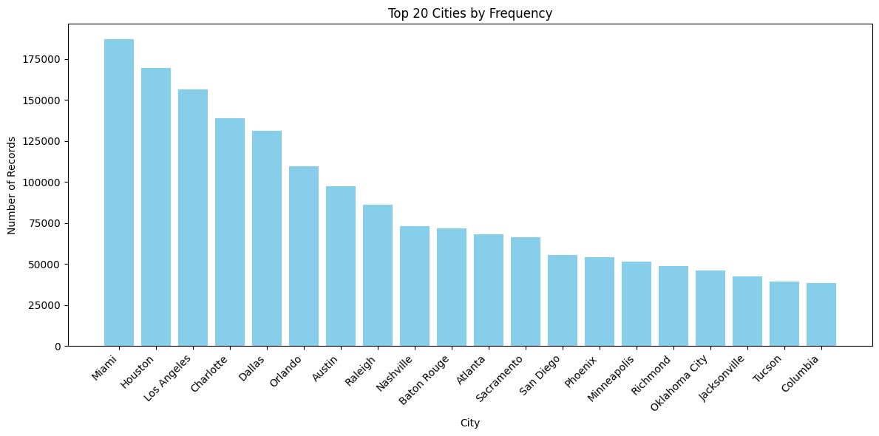
Road Accidents in Major U.S. Cities"
Top 5 cities with the highest number of road accidents:
Miami – 186,949 accidents
Houston – 178,011 accidents
Los Angeles – 166,043 accidents
Charlotte – 145,031 accidents
Phoenix – 112,511 accidents
Although New York City is the most populated U.S. city, it ranks only 45th with 25,580 accidents, indicating a lower accident rate relative to its size.

Slide 5
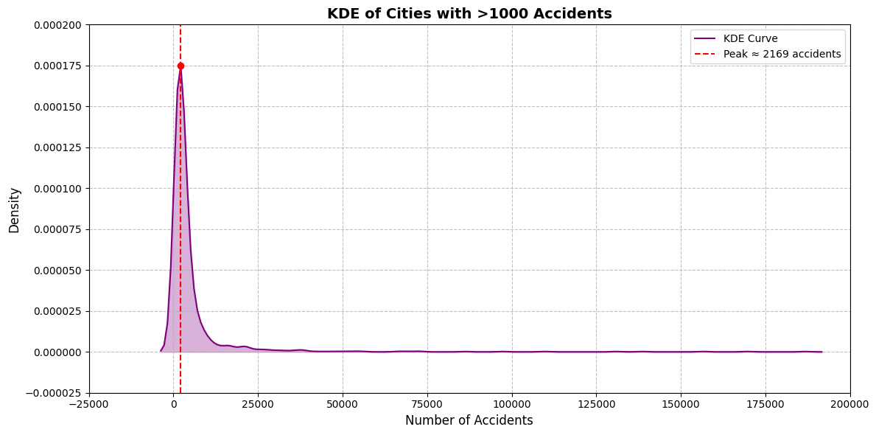
Distribution of Road Accident Counts Across Cities (KDE Curve)
The KDE curve peaks at around 2,169 accidents, meaning most cities have close to this number. Only a few cities report much higher accident counts, creating a long tail in the distribution.

Slide 6
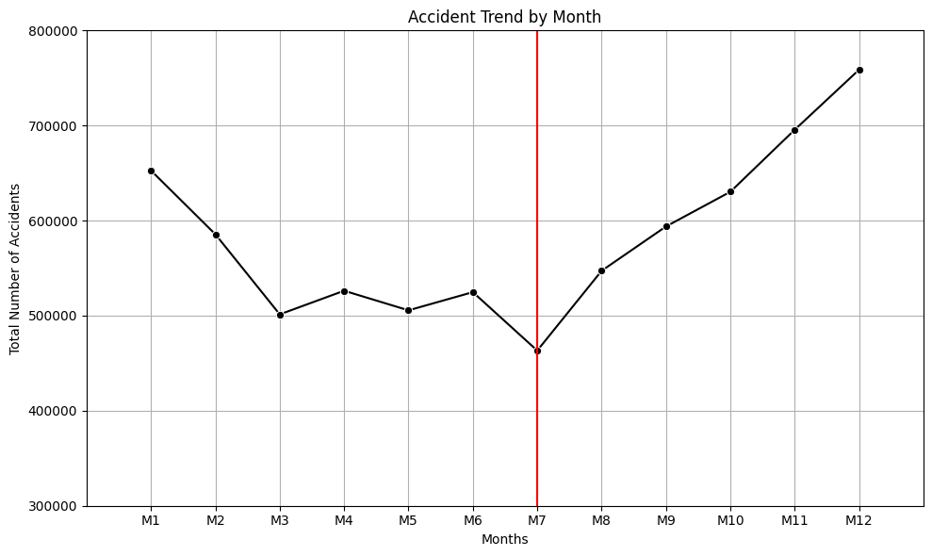
Monthly Trend of Road Accidents
The line plot showing month vs. accident count reveals a clear seasonal pattern in road accidents:
January to July: A steady decline in accidents is observed, possibly due to favorable weather conditions or increased awareness campaigns early in the year.
August to December: A gradual rise starts in August, peaking in December, which has the highest number of accidents—likely due to increased travel, festivals, and foggy weather.
The line plot of month vs. accident count shows a clear seasonal trend. Accidents are lowest in July (Month 7) and gradually increase towards the end of the year. December records the highest number of accidents, indicating a possible link to winter and holiday travel.

Slide 7
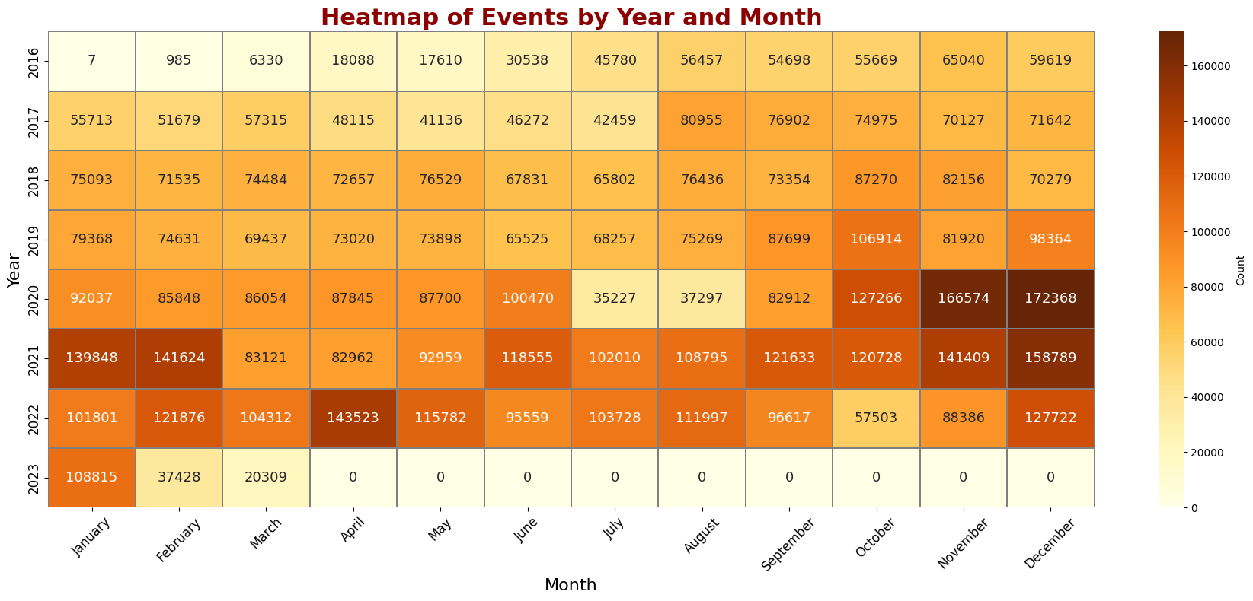
Monthly Accident Patterns Across Different Years

Slide 8
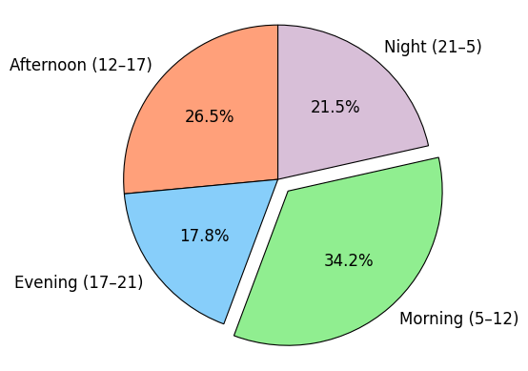
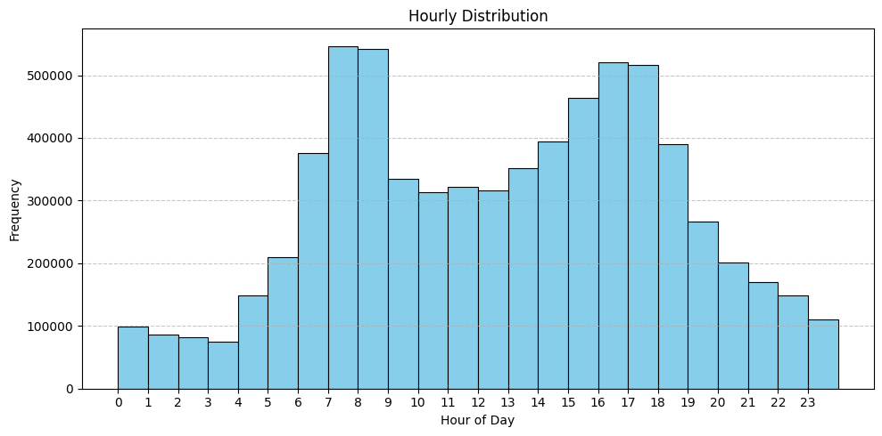
Distribution of Accidents by Temperature Category
7 AM – 9 AM and 4 PM – 6 PM, with over 500,000 accidents in each time block.
Fewer accidents occur during noon to 4 PM (less than 100000) with the lowest around 3 PM – 4 PM.
Most accidents occur during daylight hours (5–17) — totaling over 60%.
Night + Evening still contribute a significant 39%.

Slide 9
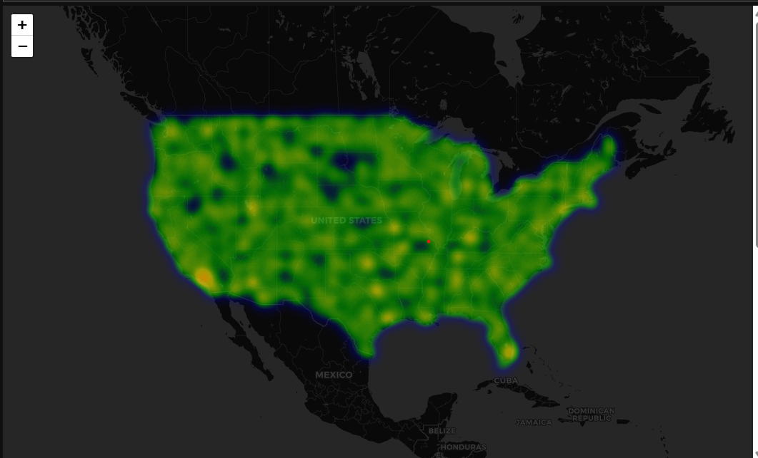
Geographic Distribution of Accidents in the US
The map visualizes accident density across the United States.
The map visualizes accident density across the United States.
Darker or denser regions indicate areas with higher accident frequency.
Urban centers and major highways show intense clustering, revealing traffic-heavy zones with more incidents.
Notes:
z

Slide 10
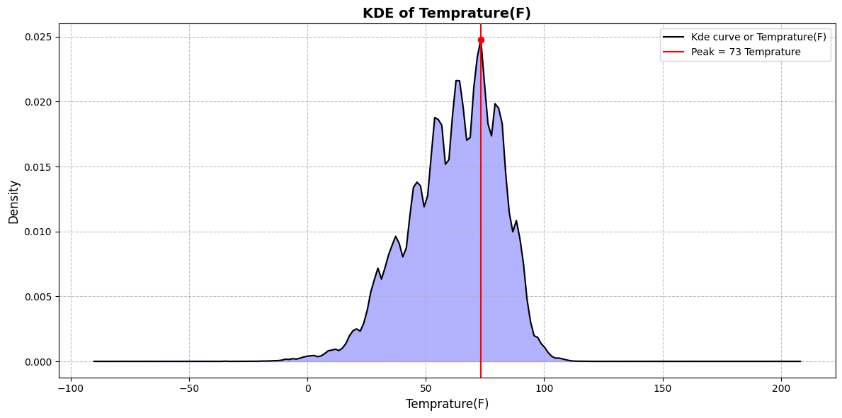
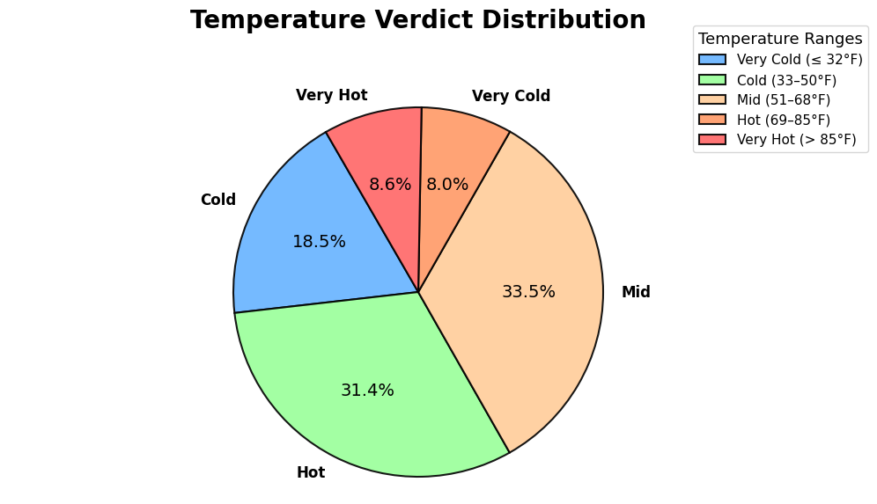
Impact of Temperature on Accident Frequency
Hot and Mid-temperature categories together account for the majority of accidents, each with over 2.4 million incidents.
Most accidents occur around 73°F, a moderate and comfortable temperature when more people are likely to travel.
Fewer accidents happen during extreme temperatures (very hot or very cold), likely because fewer vehicles are on the road during such conditions.
Hot and Mid-temperature categories together account for the majority of accidents, each with over 2.4 million incidents
Very Cold and Very Hot categories have the fewest, with around 0.6M–0.8M cases, indicating reduced road activity in extreme weather.

Slide 11
Key Findings & Trends
Hot and Mid-temperature categories together account for the majority of accidents, each with over 2.4 million incidents.
Top Cities: Miami, Houston, Los Angeles, Charlotte And Pheonix report the most accidents, with City Miami recording the highest number that is 186,949 accidents.
Monthly Pattern: Accidents peak in December and are lowest in July, first the accident decrease from
January to July then from July to December it increases Linearly.
Yearly Trend: 2021 recorded the highest number of accidents, crossing 1.2 million cases.
Peak Hours: More than 500,000 accidents occurred during 7–9 AM and 4–6 PM, aligning with rush hours.
Low Noon Risk: Fewer accidents occur between 12–4 PM, with the minimum around 3–4 PM.
Temperature Effect: KDE reveals most accidents happen around 73°F, the most frequent temperature.
Temp Category Impact: Combined Mid and Hot categories account for over 1.2 million accidents.
Regional Clusters: Eastern and southern U.S. show denser accident concentrations on the geographical map

Slide 12
Thank you

